Slide 1
Case Study 2: Lending Club
Team 4: Emily Strong & Raksha Kaverappa

Slide 2
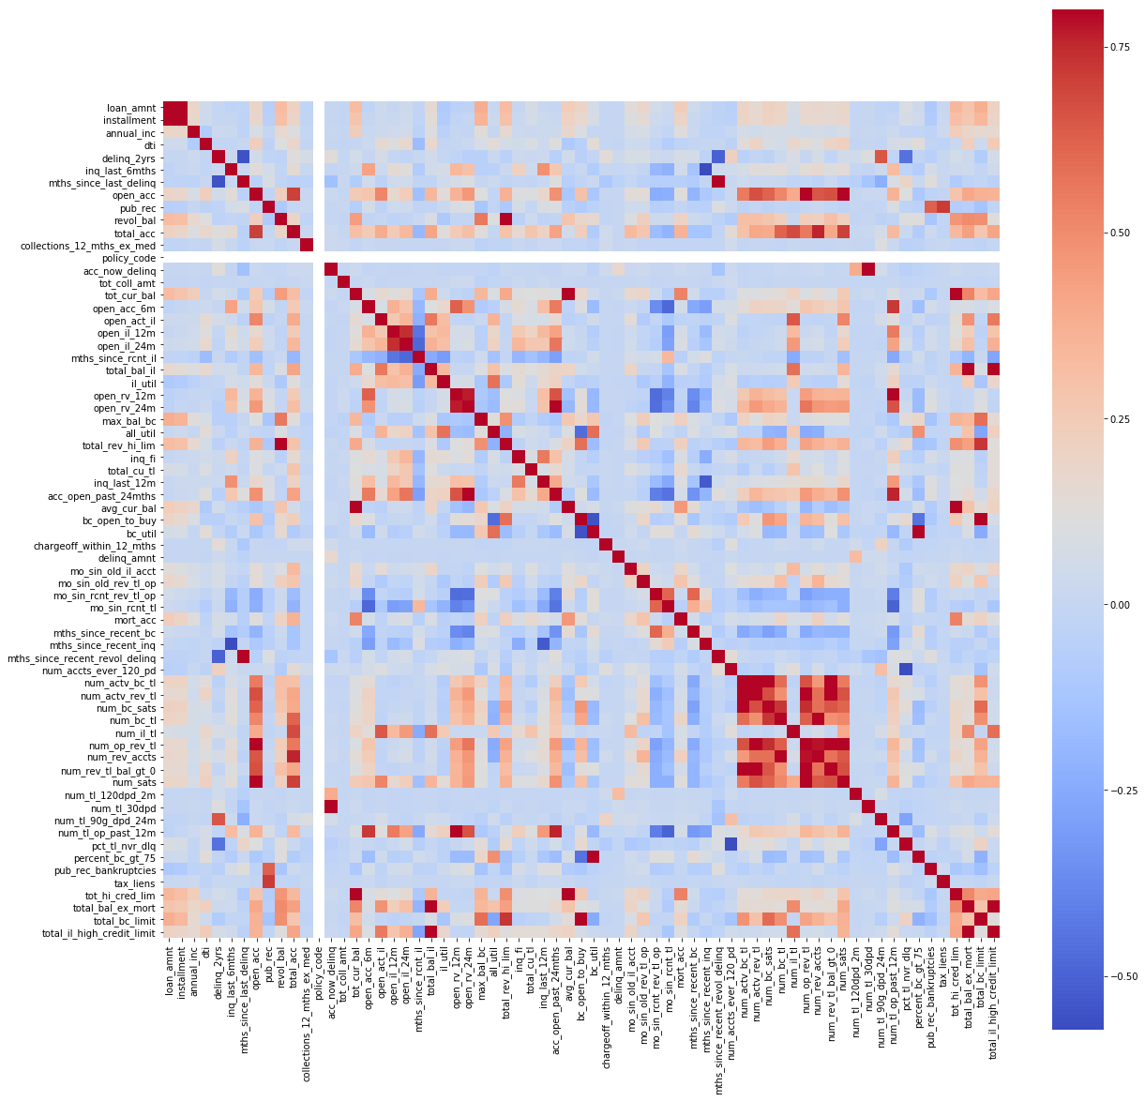
Data Wrangling

Slide 3
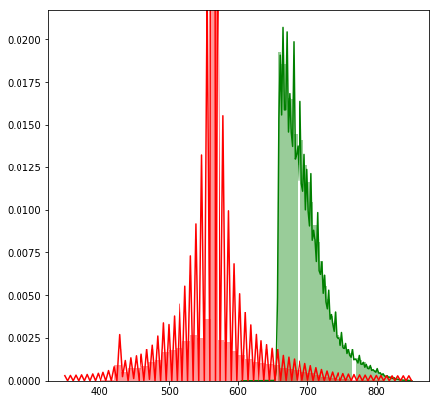
Loan Applicants: Credit Scores
Lending Club requires a minimum credit score of 660 to be approved. Plotting credit scores for declined (red) versus approved (green) loans shows this cutoff.

Slide 4
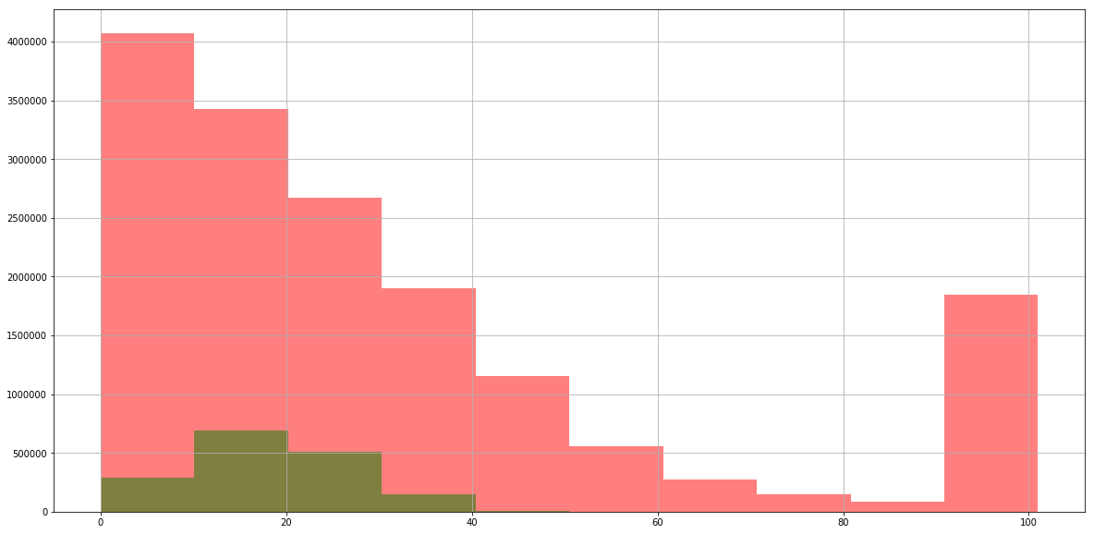
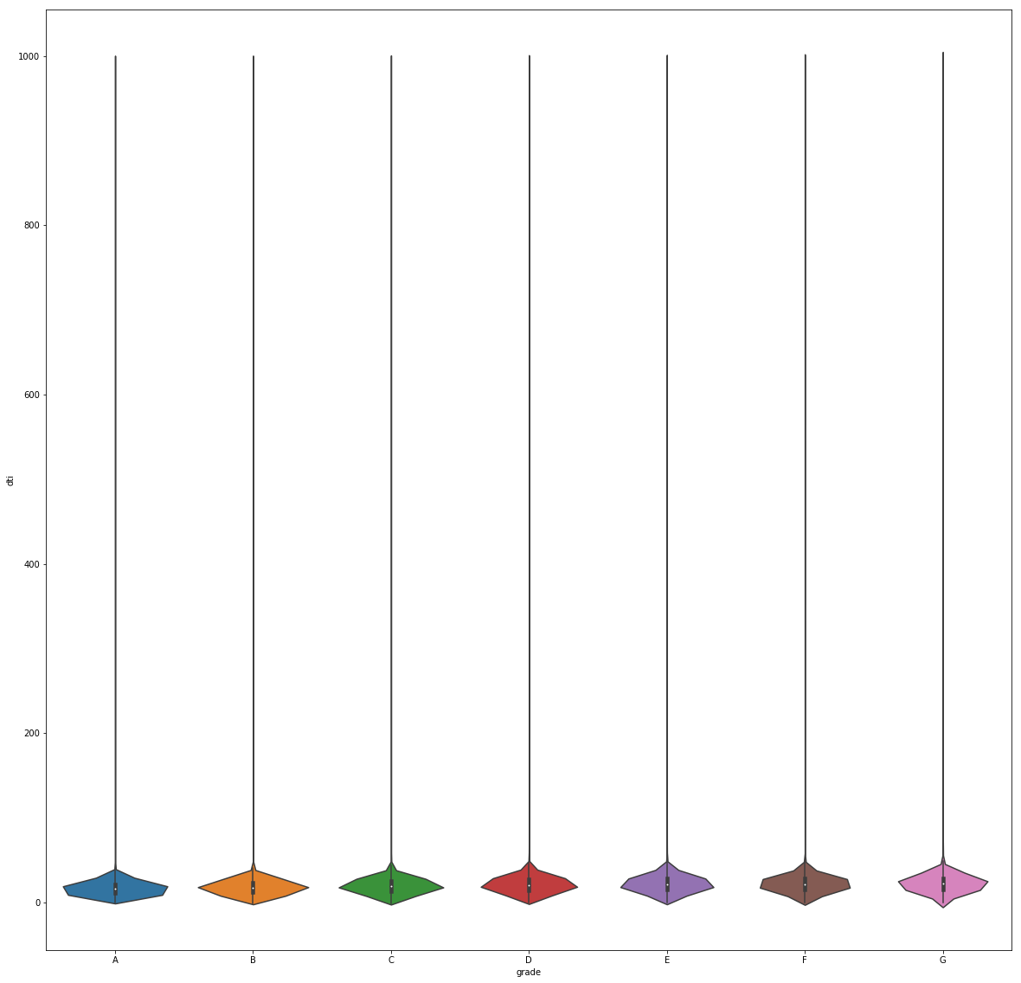
Who Applied: Debt-To-Income Ratio
There is also a maximum debt-to-income ratio of 40% to be approved. There are exceptions however, as a plot of just DTI for approved loans shows.
DTI All Loans
DTI Approved Loans by Grade

Slide 5
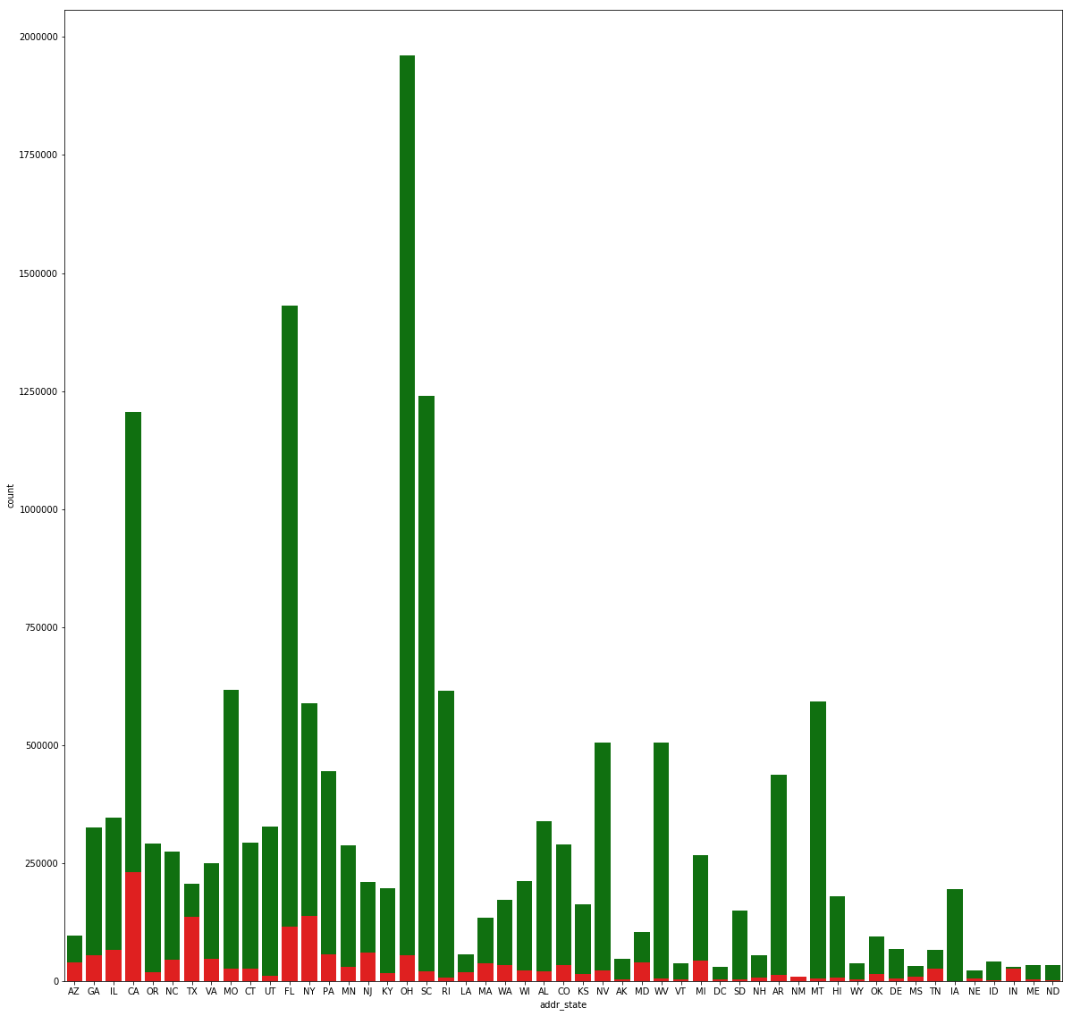
Who Applied: State Residency

Slide 6
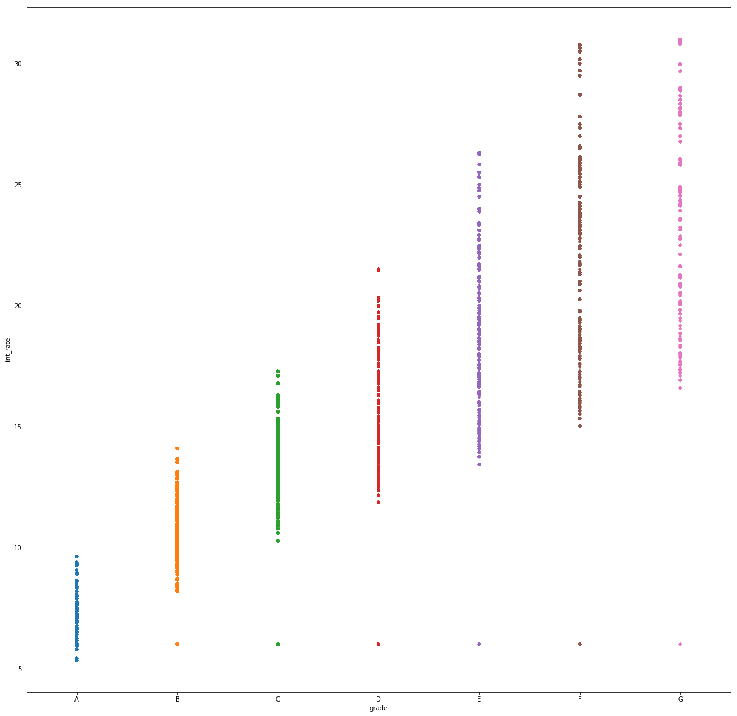
Interest Rate Clustering
Lending Club assigns each approved loan a grade (A-G) and a sub-grade (1-5) to determine the interest rate.
Interest rates are calculated based on a base (~5%) plus a risk adjustment set using the A1-G5 sub-grade.

Slide 7
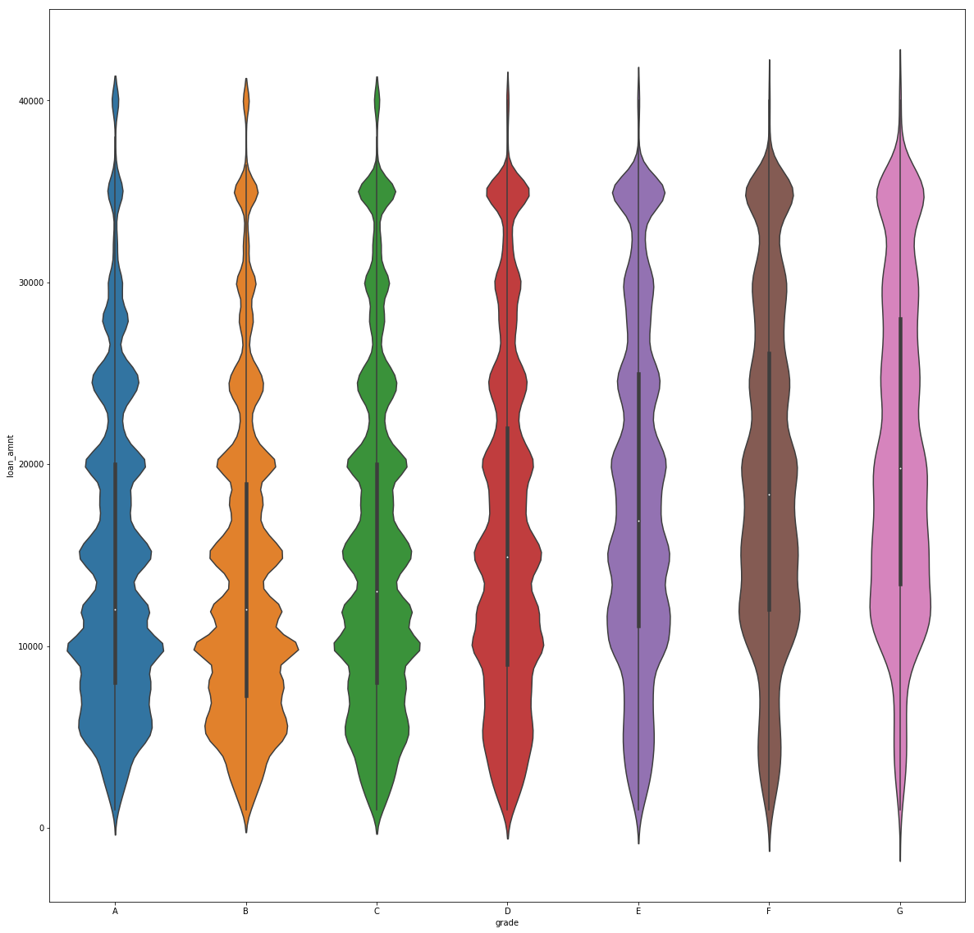
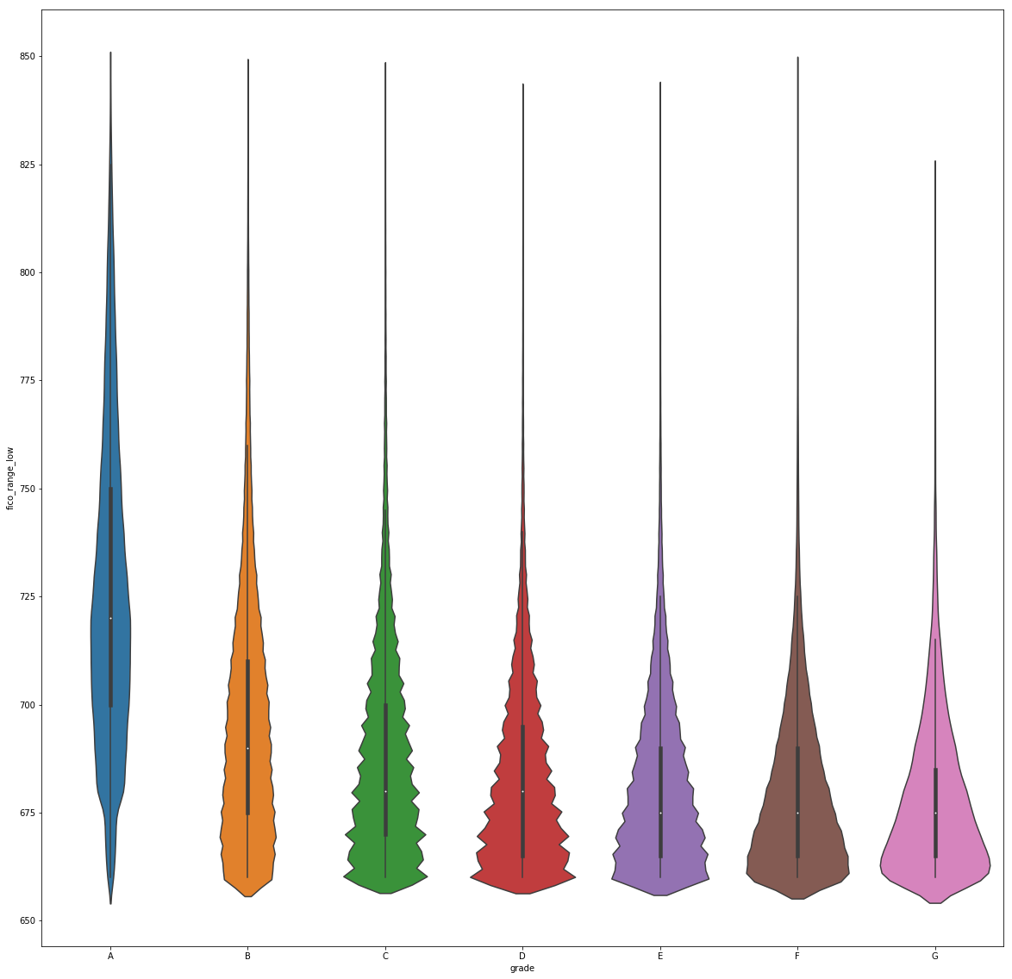
How Loans Are Clustered
Aspects of both the loan and the applicant’s credit report are factored into the grade, including loan term and amount, credit score, debt-to-income ratio, and home ownership.
Loan Amount by Grade
FICO Score by Grade

Slide 8
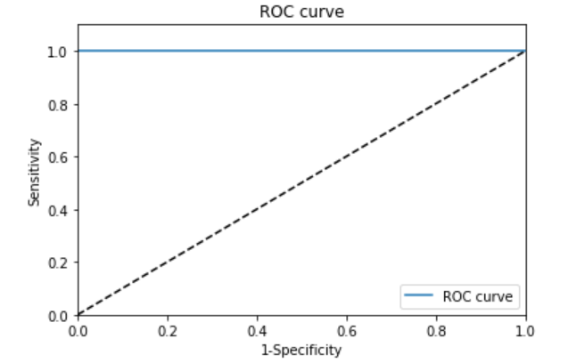
Classification Models
Because the Lending Club loan qualification criteria are clearly defined, our classification models all performed well. We chose to use Random Forests for API deployment.
Confusion Matrix:
Model | True Positives | False Positives | True Negatives | False Negatives
Logistic Regression | 3216939 | 8949 | 302817 | 108
Random Forest | 3226328 | 0 | 302485 | 0
Neural Networks | 3224991 | 0 | 303822 | 0
ROC Curve for Random Forests

Slide 9
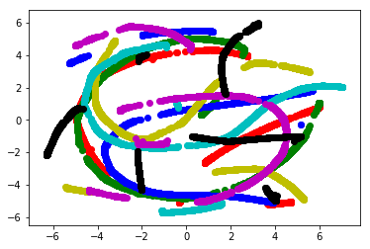
Clustering
We attempted to recreate the Lending Club grades with our KMeans clusters, and chose the clusters that came the closest but as our T-SNE plot shows below, there is still significant overlap between the groups.
For manual clustering, we chose to use FICO score

Slide 10
Prediction Models
We used 40 features for prediction, and had the best accuracies with non-linear prediction models.
For our non-clustered data and KMeans clusters Neural Network had less error by a small margin in Python, whereas Random Forest had less error for our manual clusters.
Example Error Rates:
KMeans Cluster 0 | Jupyter Notebook |  |  |  |  |  | Azure ML
Metric | Train RMS | Test RMS | Train MAE | Test MAE | Train MAPE | Test MAPE | Test MAE | Test RMS
Linear Regression | 3.57 | 3.53 | 2.77 | 2.76 | 24.27 | 24.40 | N/a | N/a
Neural Network | 3.07 | 3.20 | 2.34 | 2.44 | 19.95 | 20.79 | 2.59 | 3.32
Random Forest | 1.23 | 3.23 | 0.93 | 2.48 | 7.99 | 21.37 | 2.56 | 3.34
KNN | 3.80 | 4.63 | 2.96 | 3.62 | 26.61 | 32.67 | N/a | N/a

Slide 11
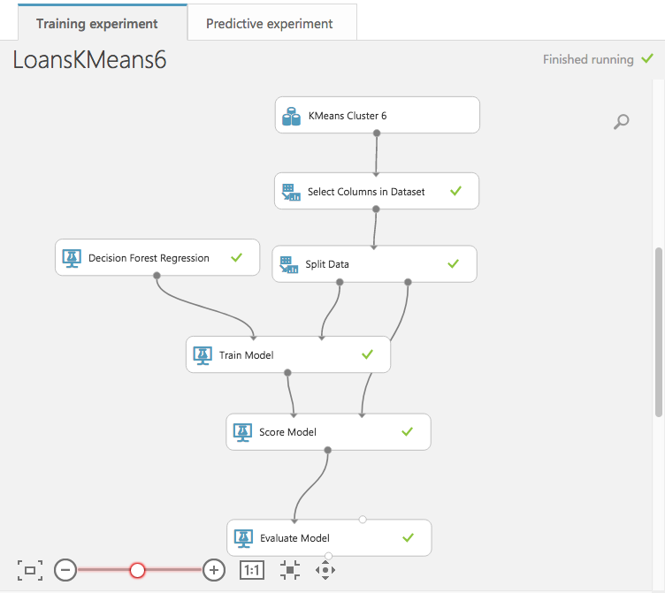
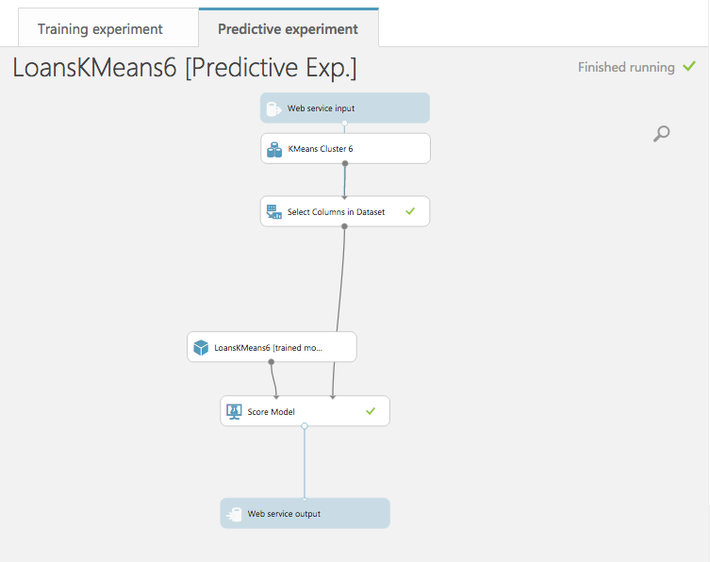
API Deployment
Although the data without clustering and KMeans clusters performed better with Neural Networks
in Python, Azlure ML’s implementation of the algorithm was not optimal and we chose to use
Random Forest for all APIs
Example Training Workflow:
Example Web Service Workflow:

Slide 12
Deployment
We deployed the final workflow using Jupyter Notebook
It accepts user input, grouping our selected 40 features into required and optional inputs
It then cleans the input, calls the classification API and returns a message that the application was declined or assigns clusters and calls the prediction APIs, returning the highest calculated interest rate

Slide 13
Conclusion
Lending club has a straight-forward method of accepting or declining loan applications but their model for assigning interest rates is much more complex
As a result we had high accuracy with our classification model, but our results for prediction were less accurate and non-linear methods had greater overall accuracy
Error rates varied significantly between clusters suggesting some groupings approximated Lending Club’s grades more closely than others

